Slide 1
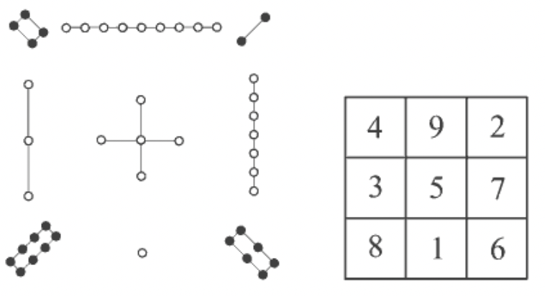
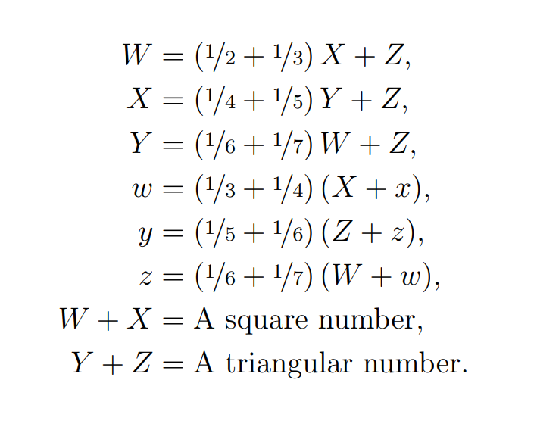
A Historical Narrative of Mathematical Puzzles
By Ryan Y. Batubara
Pascal: “Mathematics is too serious, and therefore, no opportunity should be missed to make it amusing.”
A Sphinx Riddle (670s BC, Aeschylus)
"Which creature has one voice and yet becomes four-footed and two-footed and three-footed?"
This is considered the most famous riddle of all time, popularizer of all other riddles.
Josephus Problem (370s, Josephus)
Prisoners stand in a circle. Counting begins at a point of your choice in a specified direction. After a specific number of people are skipped, the next is executed. Repeat, starting with the next person, until the last one standing is freed. Given the specified values, can you find a starting point that frees a certain prisoner?
The dark ages not only featured dark puzzles, but also computationally expensive ones.
Luo Shu 洛书 (2200s BC, Feng Shui)
Chinese Mathematicians tried to create a 3x3 grid of the numbers 1 to 9, where the sum of numbers on the rows, columns, and diagonals were equal. Now called the magic square.
Cattle Problem (200s BC, Archimedes)
The sun god had a herd of cattle consisting of W, X, Y, Z respectively of white, black, spotted, and brown bulls and w, x, y, z of cows, satisfying:
Compute T = W + X + Y + Z + w + x + y + z.
This requires a computer. Remove last two conditions when solving by hand.
A River Crossing (800s, Alcuin)
A man had to take a wolf, a goat, and a bunch of cabbages across a river. The only boat he could find could only take two of them at a time. How?
The wolf will eat the goat, and the goat will eat the cabbage, unattended. One of the first explicit uses of puzzles to teach math.
Rabbit Problem (1100s, Fibonacci)
A man leaves a pair of rabbits in a pen. How many pairs of rabbits can be produced from that pair in a certain number of months if it is supposed that every month each pair begets a new pair, which from the second month on becomes productive?
Very famous instance of puzzle leading to groundbreaking Fibonacci sequence.
Babylon’s Commerce (1800-1600 BC)
A Babylonian text reads:
The igibūm exceed igūm by 7.
What are the igūm and ibigūm [ igū ]?
When put in standard mathematical notation,
The number x exceeds y by 7.
What are x and y, if x times y equals 60?
List the techniques you used to solve this. How many do you think were available then?
They had a crude quadratic formula that found
x = √( (7/2)² + 60) ) + 7/2 = 12,
y = √( (7/2)² + 60) ) - 7/2 = 5
unaware of the negative solution x = -5, y = 12.
A Chinese Rice Bundle (100s BC, ???)
Top-grade ears of rice three bundles, medium-grade ears two bundles, low-grade ears one bundle, makes 39 dou; top-grade ears of rice two bundles, medium-grade three bundles, low-grade ears one bundle, makes 34 dou; Top-grade ears of rice one bundle, medium-grade two bundles, low-grade three bundles, make 26 dou. How many dou are there in a bundle of top-grade, medium-grade, and low-grade?
The Chinese textbook containing the above solved it with rectangular arrays, and one of the first versions of “Gaussian elimination” for matrices recorded.
17 Horses (1500s AD, Tartaglia)
A man dies leaving 17 horses to be divided amongst his heirs in the proportions 1/2 : 1/3 : 1/9. How?
Is there a logical solution without borrowing?
Babylon’s Commerce, A Chinese Rice Bundle, A River Crossing, and 17 Horses were taken from “A History of Recreational Mathematics” by Barry Clarke in 1994.
Page 1
Luo Shu, A Cattle Problem, A Sphinx Riddle Josephus Problem, and Rabbit Problem were taken from “Famous Puzzles of Great Mathematicians” by Miodrag Petković in 2009.

Slide 2
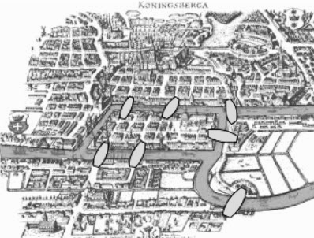
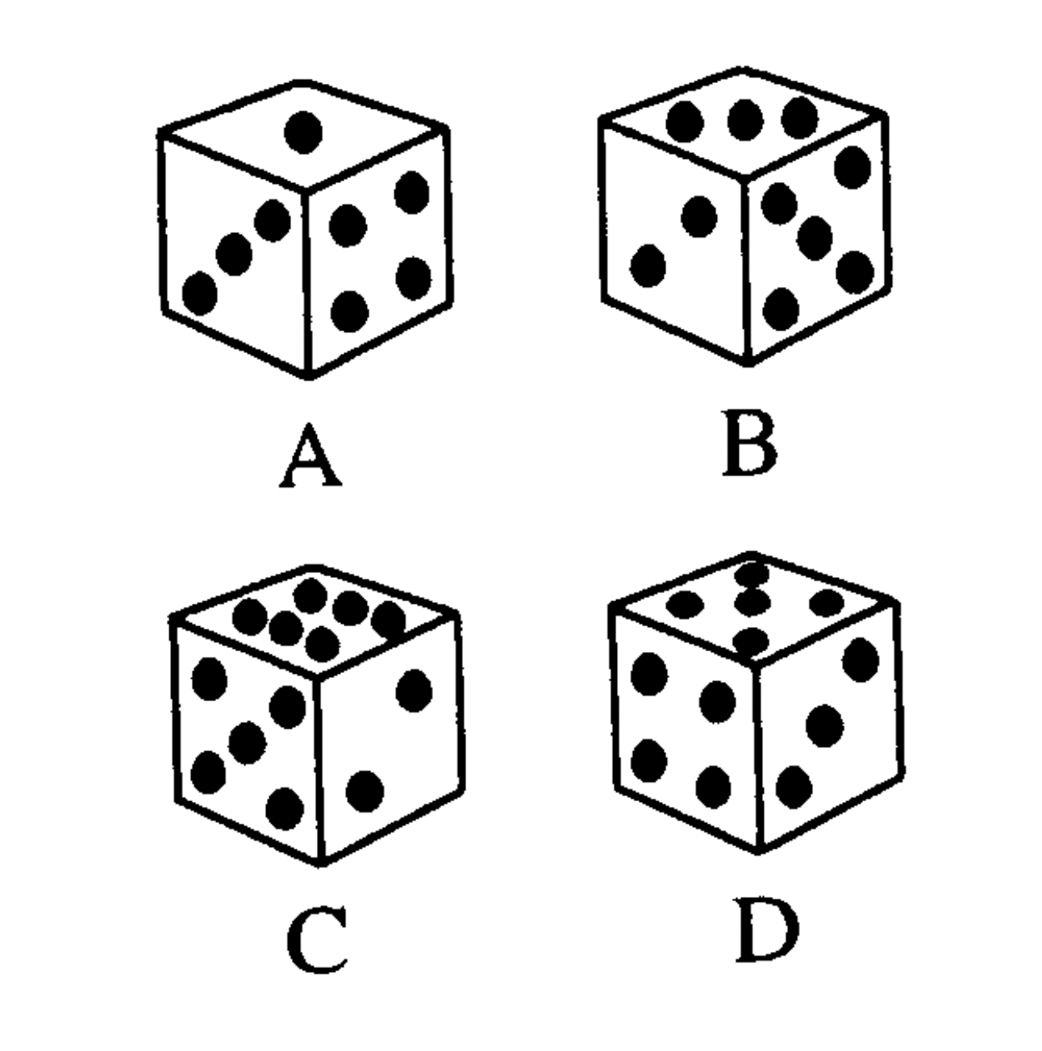
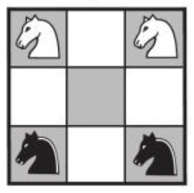
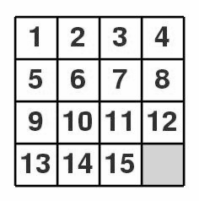
Chess Puzzles (1500s, Guarini)
Assuming standard chess rules, what is the minimum number of moves to exchange the positions of the white and black knights? One of the first “Chess Puzzles.”
Seven Bridges of Kӧnigsberg (1736)
“Can you take a walk through the town, visiting each part of the town and crossing each bridge only once?
Considered one of the most influential puzzles of all time, as it led Euler to formulate the basis of graph theory and topology.
The Doubtful Die (1993, Barry Clarke)
These die are faulty; their opposites do not add to 7. Three are views of the same die, the other a rogue die. Which is the rogue die?
World Flight (1994, Martin Gardner)
You intend to fly non-stop around the world. But a full tank only takes you halfway. You can arrange many places exactly like yours to assist with refueling. You can only use the starting airport, and refueling can be done mid-air. Ignoring fueling times, what is the minimum number of places necessary?
Consider version with 1/3 not 1/2. Gardner is considered most influential recent puzzlist.
Cat & Mouse (1500s, Buteo/Pacioli)
Considered one of the most difficult arithmetic sequence puzzles of all time.
A mouse is at the top of a poplar tree 60 braccia high, and a cat is on the ground at its foot. The mouse descends 1/2 of a braccia a day and at night it turns back 1/6 of a braccia. The cat climbs one braccia a day and goes back 1/4 of a braccia each night. The tree grows 1/4 of a braccia between the cat and the mouse each day and it shrinks 1/8 of a braccia every night. In how many days will the cat reach the mouse and how much has the tree grown in the meantime, and how far does the cat climb?
The 15 Puzzle (1800s, Samuel Loyd)
From any given position, slide the blocks to the ordered arrangement above. Was popular; Loyd is one of the greatest puzzle populizers.
Dotty Japan (2021, Alex Bellos)
Here is a word in Japanese Braille:
⠡ ⠑ ⠊ ⠫ ⇒ karaoke
Here are six more, with words shuffled:
⠥ ⠃ ⠩ 1) atari
⠪ ⠃ 2) koi
⠱ ⠫ 3) haiku
⠡ ⠕ ⠅ 4) katana
⠣ ⠾ ⠎ 5) kimono
⠁ ⠕ ⠓ 6) sake
What are the following words?
⠡ ⠑ ⠟ h) ⠁ ⠇ ⠿
A Literary Milestone (1600s)
The book Problèms Plaisans et Délectables published 1612 by Claude Bachet, is considered the first full mathematical recreations book. Alongside its sequel, published in 1624, it is considered as a major inspiration for all subsequent works on mathematical recreation.
Sudoku 数独 (1900s, Howard Garns)
Fill a 9x9 grid so that each column, row, and 3x3 subgrid contains all digits 1 to 9.
Very convoluted history, from France, to Indiana, to Japan, to Britain, and world.
Remark on Unique Games Conjecture.
Sudoku was taken from Sudoku.com’s “History of Sudoku.” The Doubtful Lie was taken from “A History of Rec. Math.” by Barry Clarke in 1994.
Dotty Japan taken from “A Language Lover’s Puzzle Book” by Alex Bellos in 2019.
Page 2
Chess Puzzles, Cat & Mouse, A Literary Milestone, Seven Bridges of Kӧnigsberg, and 15 Puzzle, were taken from “Famous Puzzles of Great Mathematicians” by Miodrag Petković in 2009.

Slide 3
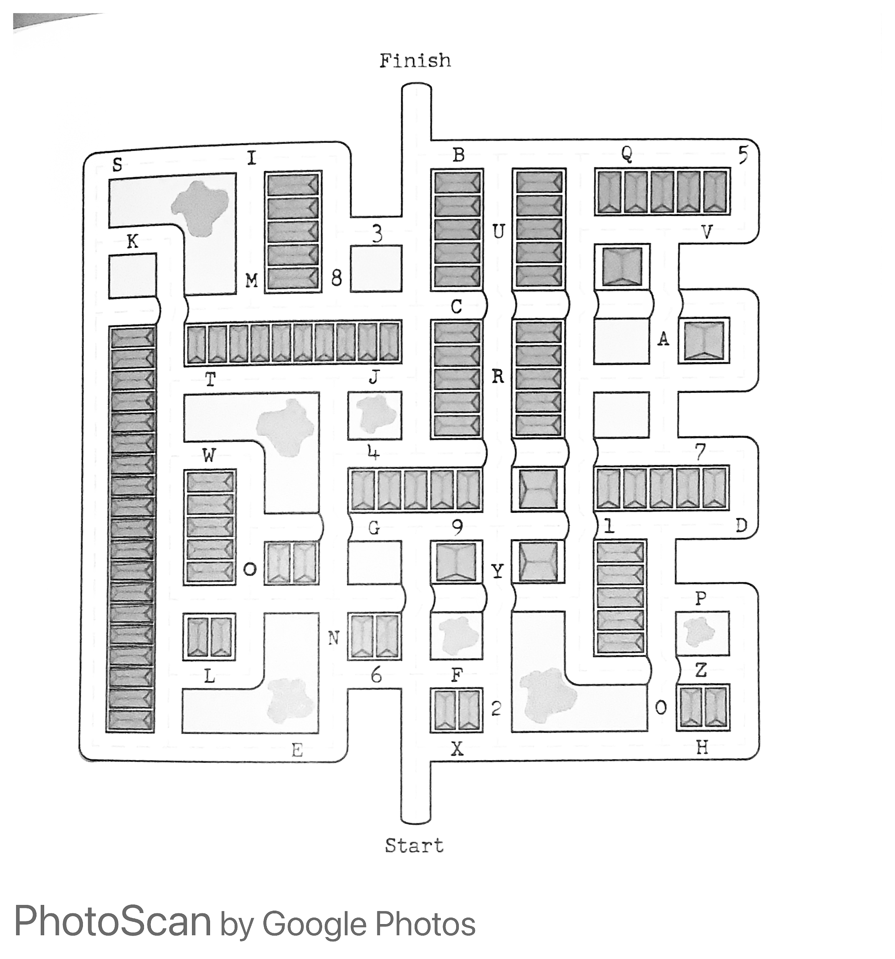

START
FINISH
Goal: Find the shortest route in the maze, from start to finish. When going under a bridge, you MUST go straight on. At all other junctions, and corners, you may NOT turn right.
Taken from “The GCHQ Puzzle Book II,” by The GCHQ in 2018.
4th Puzzle of “The GCHQ Centenary Trail”, named “Alphabet St.” Solution Here.
Goal: Find the shortest route in the maze, from start to finish. When going under a bridge, you MUST go straight on. At all other junctions, and corners, you may NOT turn right.
Taken from “The GCHQ Puzzle Book II,” by The GCHQ in 2018.
4th Puzzle of “The GCHQ Centenary Trail”, named “Alphabet St.” Solution Here.
FINISH
START
Solution Here
Solution Here

